Slide 1

Accessibility
& internationalization
Wenxuan Shi
College of Software, Nankai University
Email: shiwx@nankai.edu.cn
Wechat: 13920561100

Slide 2
Topics
Accessibility
Internationalization

Slide 3
Accessibility
Notes:
StatelessWidget is used for immutable elements that only rely on the object configuration information
StatefulWidget is used for elements that can dynamically change based on state-changes in the system
Everytime that state changes, setChange() is called by the object

Slide 4
Introduction
Flutter is committed to supporting developers who want to make their apps more accessible: usable by as many people as possible, including those with disabilities such as blindness or motor impairment.
Flutter supports three components for accessibility support:
  Large fonts: Render text widgets with user-specified font sizes
  Screen readers: Communicate spoken feedback about UI contents
  Sufficient contrast: Render widgets with colors that have sufficient contrast

Slide 5
Inspecting accessibility support
For Android:
Install the Accessibility Scanner for Android
Enable the Accessibility Scanner from Android Settings > Accessibility > Accessibility Scanner > On
Navigate to the Accessibility Scanner ‘checkbox’ icon button to initiate a scan

Slide 6
For iOS:
Open the iOS folder of your Flutter app in Xcode
Select a Simulator as the target, and click Run button
In Xcode, select Xcode > Open Developer Tools > Accessibility Inspector
In the Accessibility Inspector, select Inspection > Enable Point to Inspect, and then select the various user interface elements in running Flutter app to inspect their accessibility attributes
In the Accessibility Inspector, select Audit in the toolbar, and then select Run Audio to get a report of potential issues

Slide 7
Large fonts
Both Android and iOS contain system settings to configure the desired font sizes used by apps.
Flutter text widgets respect this OS setting when determining font sizes.
Tips for developers: Font sizes are calculated automatically by Flutter based on the OS setting. However, as a developer you should make sure your layout has enough room to render all its contents when the font sizes are increased.

Slide 8
Example
The following two screenshots show the standard Flutter app template rendered with the default iOS font setting, and with the largest font setting selected in iOS accessibility settings.

Slide 9
Screen readers
Screen readers (TalkBack, VoiceOver) enable visually impaired users to get spoken feedback about the contents of the screen.
Tips for developers:
  Turn on VoiceOver or TalkBack on your device and navigate around your app.
  If you run into any issues, use the Semantics widget to customize the accessibility experience of your app.

Slide 10
Sufficient contrast
Sufficient color contrast makes text and images easier to read.
Along with benefitting users with various visual impairments, sufficient color contrast helps all users when viewing an interface on devices in extreme lighting conditions, such as when exposed to direct sunlight or on a display with low brightness.

Slide 11
The W3C recommends:
At least 4.5:1 for small text (below 18 point regular or 14 point bold)
At least 3.0:1 for large text (18 point and above regular or 14 point and above bold)

Slide 12
Tips for developers
Make sure any images you include have sufficient contrast.
When specifying colors on widgets, make sure sufficient contrast is used between foreground and background color selections.

Slide 13
More information
For more information, particularly about how to configure the semantics tree, see the following articles written by community members:
A deep dive into Flutter’s accessibility widgets
Semantics in Flutter

Slide 14
Internationalization
Notes:
StatelessWidget is used for immutable elements that only rely on the object configuration information
StatefulWidget is used for elements that can dynamically change based on state-changes in the system
Everytime that state changes, setChange() is called by the object

Slide 15
What you’ll learn
How to track the device’s locale (the user’s preferred language).
How to manage locale-specific app values.
How to define the locales an app supports.

Slide 16
If your app might be deployed to users who speak another language then you’ll need to “internationalize” it.
That means you’ll need to write the app in a way that makes it possible to “localize” values like text and layouts for each language or “locale” that the app supports.

Slide 17
Sample internationalized apps
If you’d like to start out by reading the code for an internationalized Flutter app, here are two small examples.
Minimal internationalization
Internationalization based on the intl package

Slide 18
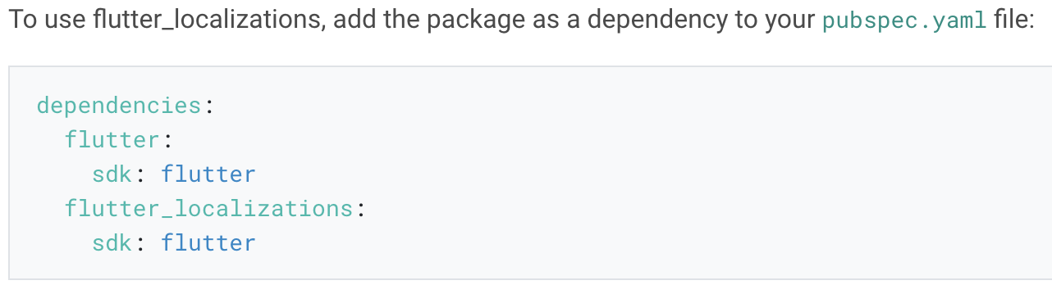
Setting up an internation­alized app
By default, Flutter only provides US English localizations.
To add support for other languages, an application must specify additional MaterialApp properties, and include a separate package called flutter_localizations.

Slide 19
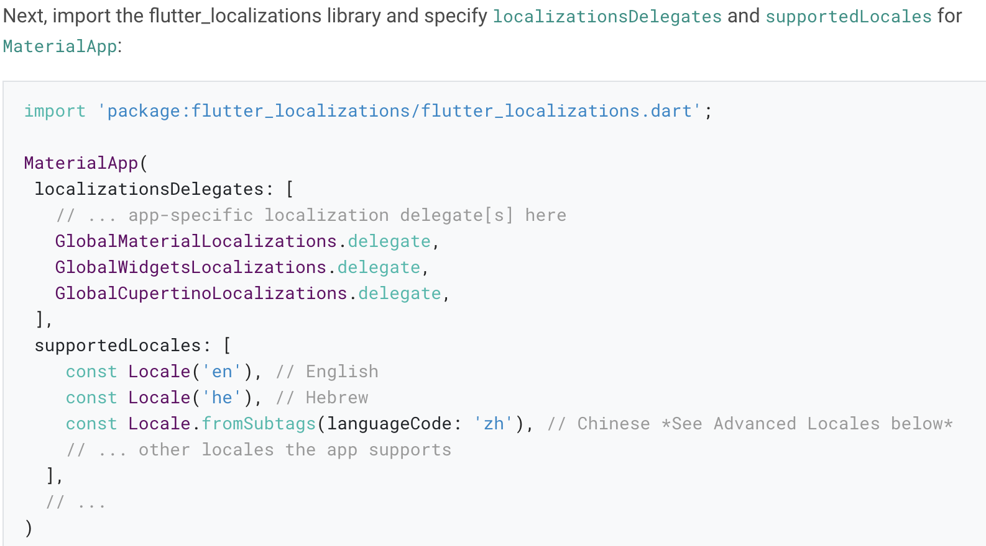

Slide 20
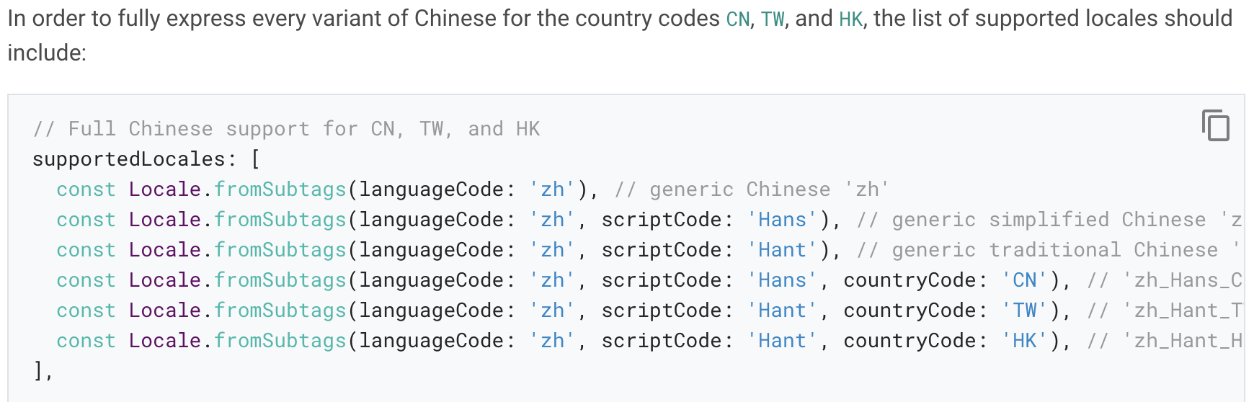
Advanced locale definition
Some languages with multiple variants require more than just a language code to properly differentiate.

Slide 21
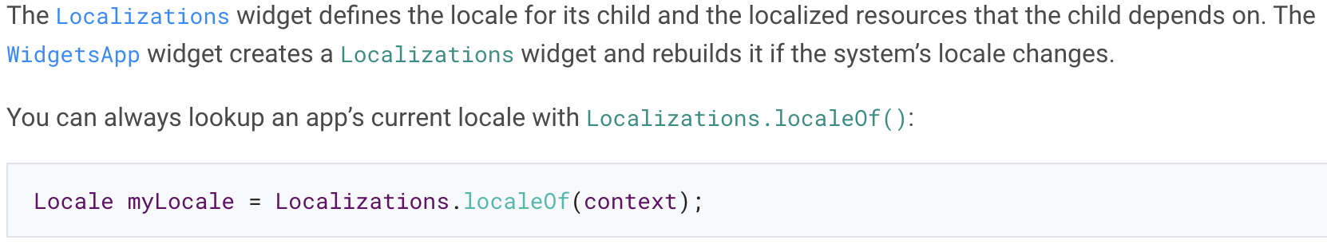
Tracking the locale
The Locale class identifies the user’s language.
Mobile devices support setting the locale for all applications, usually using a system settings menu. Internationalized apps respond by displaying values that are locale-specific.

Slide 22
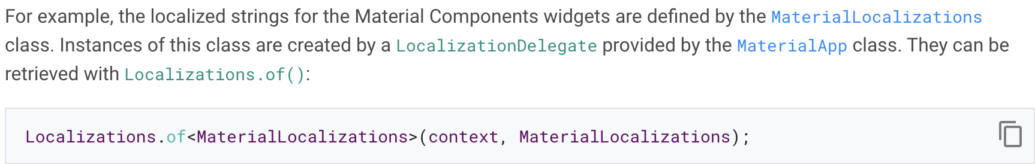
Loading and retrieving localized values
The Localizations widget is used to load and lookup objects that contain collections of localized values.
Apps refer to these objects with Localizations.of(context,type).

Slide 23
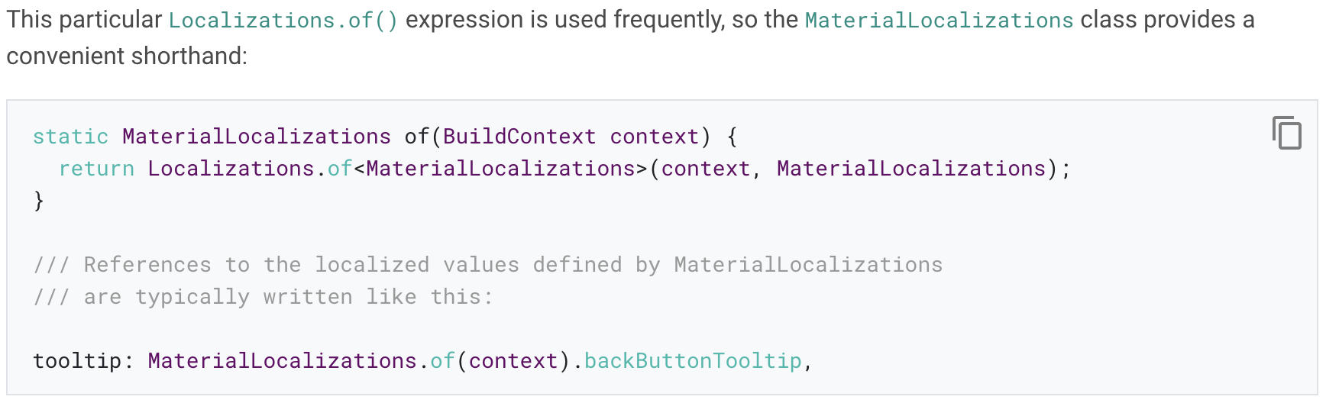

Slide 24
Using the bundled Localizations­Delegates
To keep things as small and uncomplicated as possible, the flutter package includes implementations of the MaterialLocalizations and WidgetsLocalizations interfaces that only provide US English values.
These implementation classes are called DefaultMaterialLocalizations and DefaultWidgetsLocalizations, respectively.

Slide 25
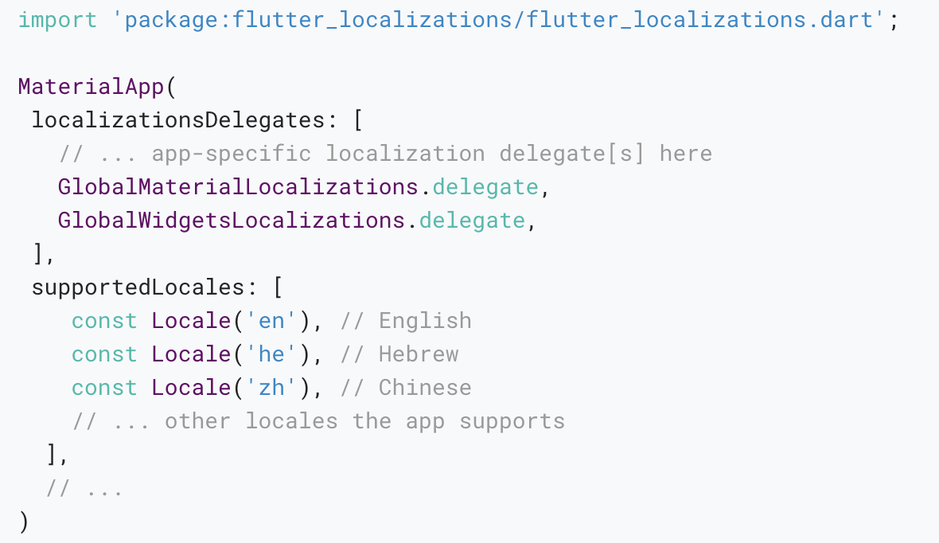
International apps must specify localization delegates for these classes.

Slide 26
Defining a class for the app’s localized resources
Putting all of this together for an internationalized app usually starts with the class that encapsulates the app’s localized values.
The example that follows is typical of such classes.
Complete source code for the intl_example for this app.

Slide 27
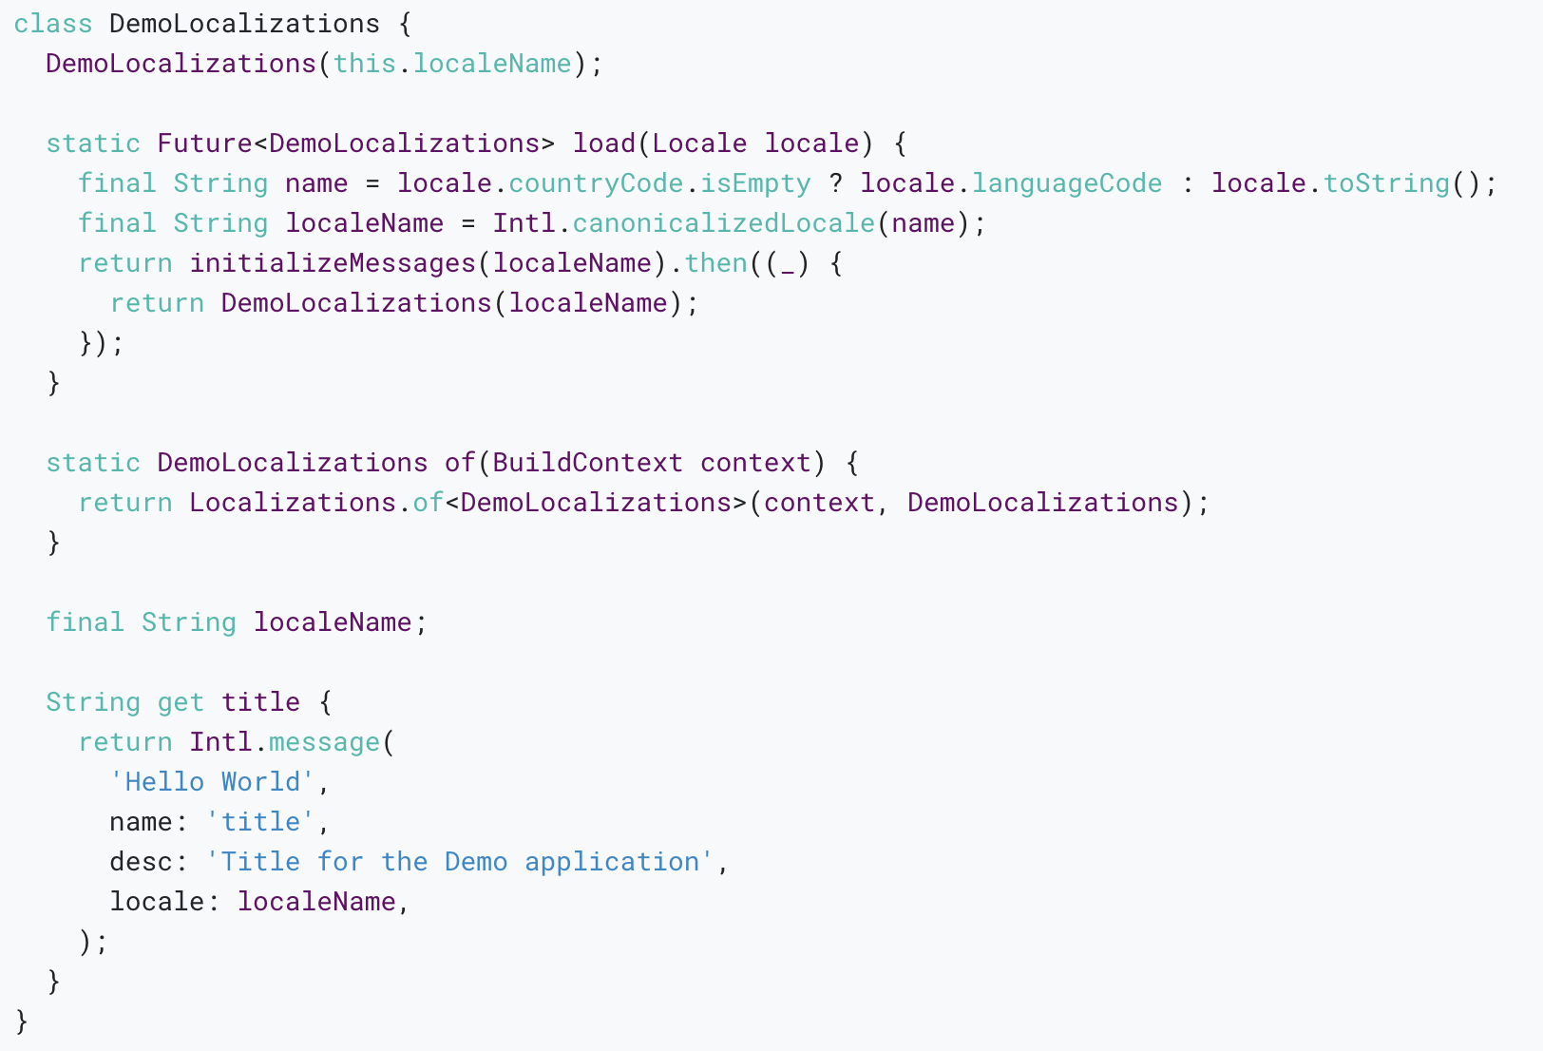
The DemoLocalizations class contains the app’s strings translated into the locales that the app supports.

Slide 28
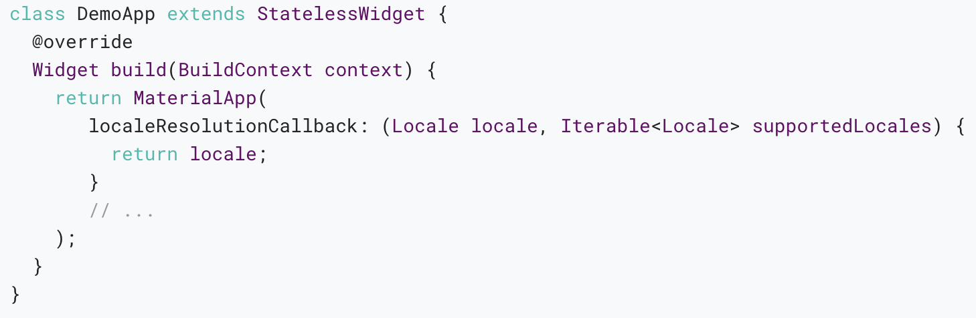
Specifying the app’s supported­Locales parameter
Although Flutter’s flutter_localizations library includes support for 77 languages, only English language translations are available by default.
An app that wants to use a different “locale resolution” method can provide a localeResolutionCallback.

Slide 29
An alternative class for the app’s localized resources
Developers can choose their own approach for managing localized values for the sake of simplicity or perhaps to integrate with a different i18n framework.
Complete source code for the minimal app.
In this version of DemoApp the class that contains the app’s localizations, DemoLocalizations, includes all of its translations directly in per language Maps.

Slide 30
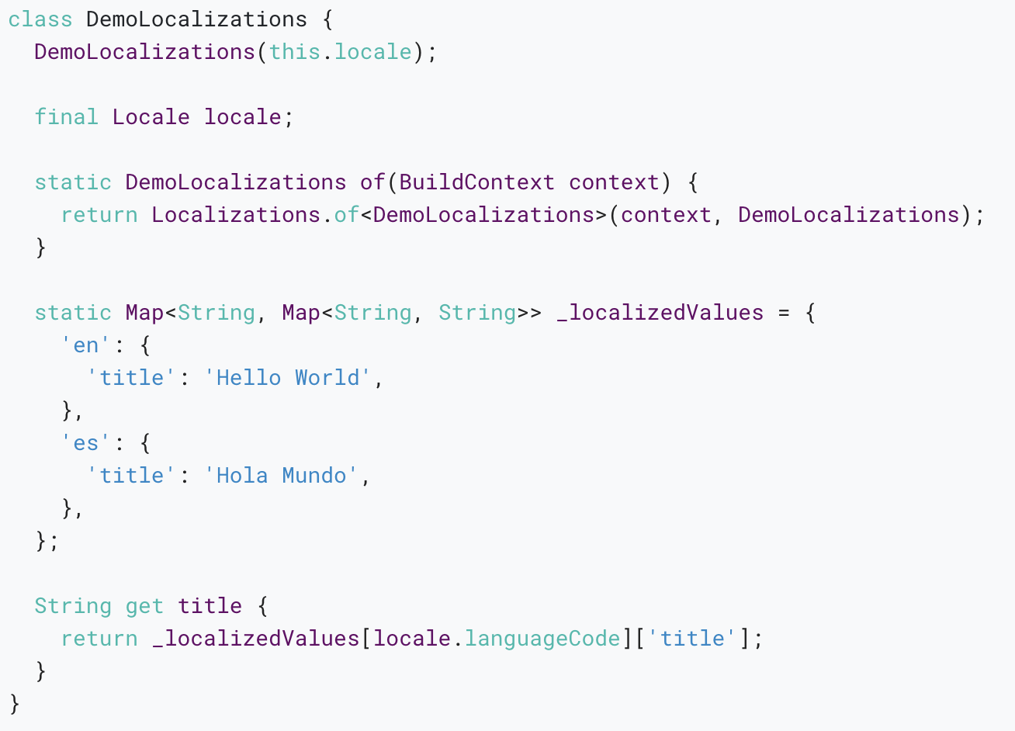

Slide 31
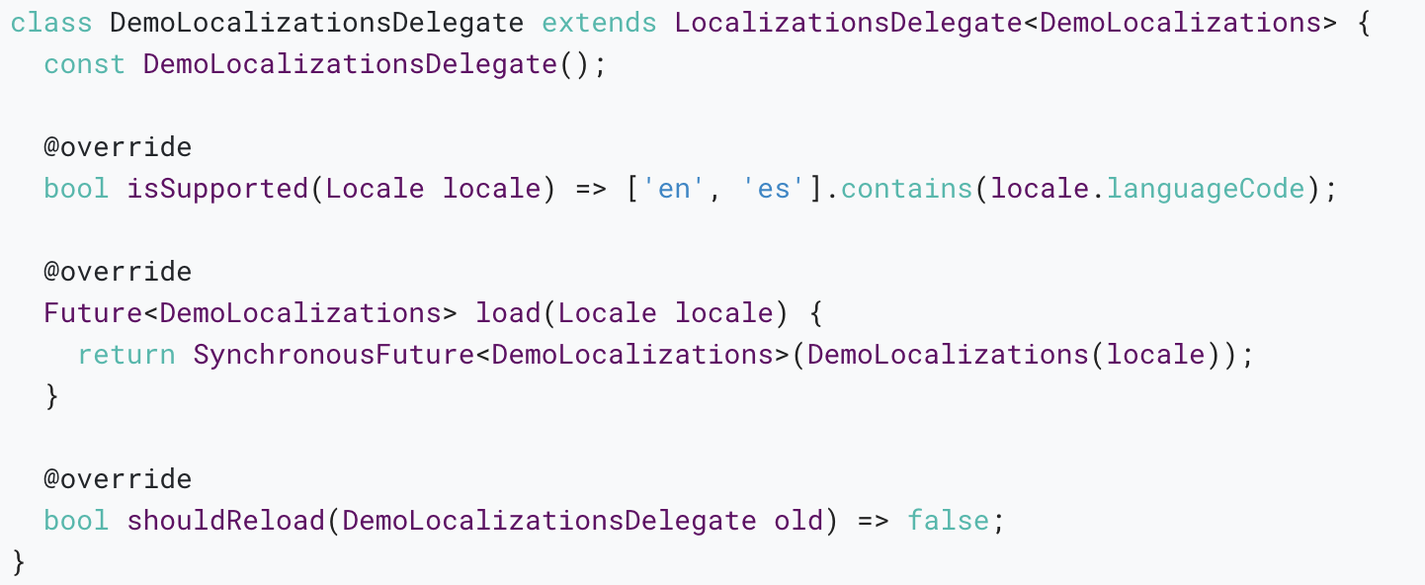
In the minimal app the DemoLocalizationsDelegate is slightly different.
Its load method returns a SynchronousFuture because no asynchronous loading needs to take place.

Slide 32
Adding support for a new language
An app that needs to support a language that’s not included in GlobalMaterialLocalizations has to do some extra work: it must provide about 70 translations (“localizations”) for words or phrases.
For more information about localization strings, see the flutter_localizations README.

Slide 33
Thank you!
Wenxuan Shi
College of Software, Nankai University
Email: shiwx@nankai.edu.cn
Wechat: 13920561100

